Slide 1
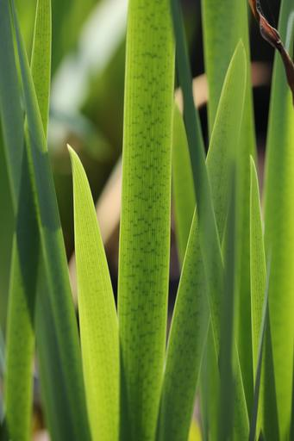

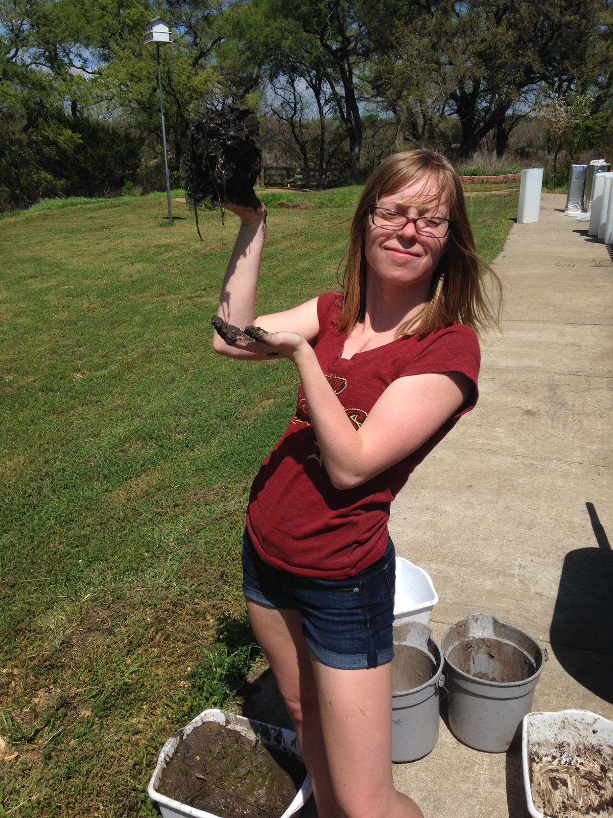
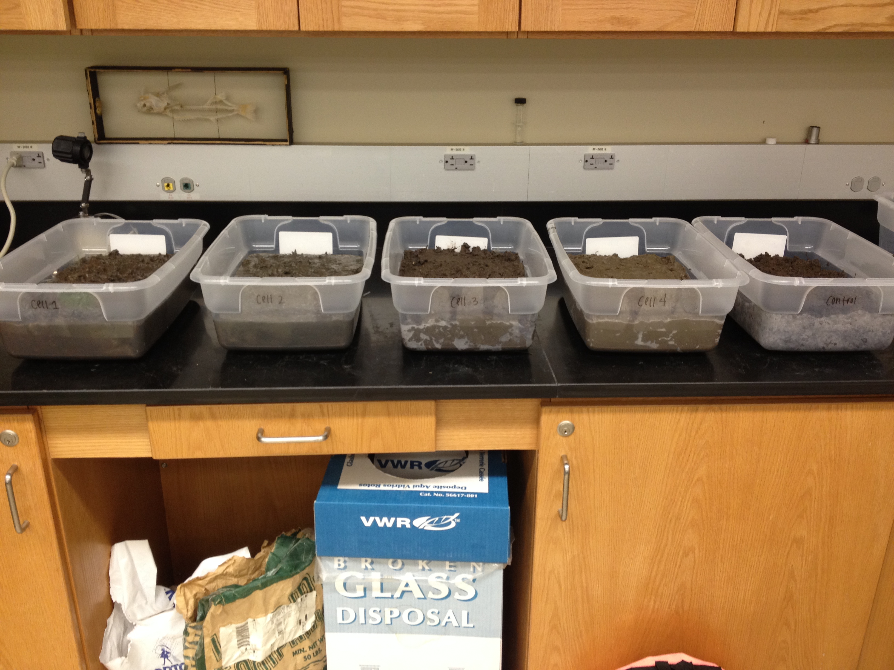
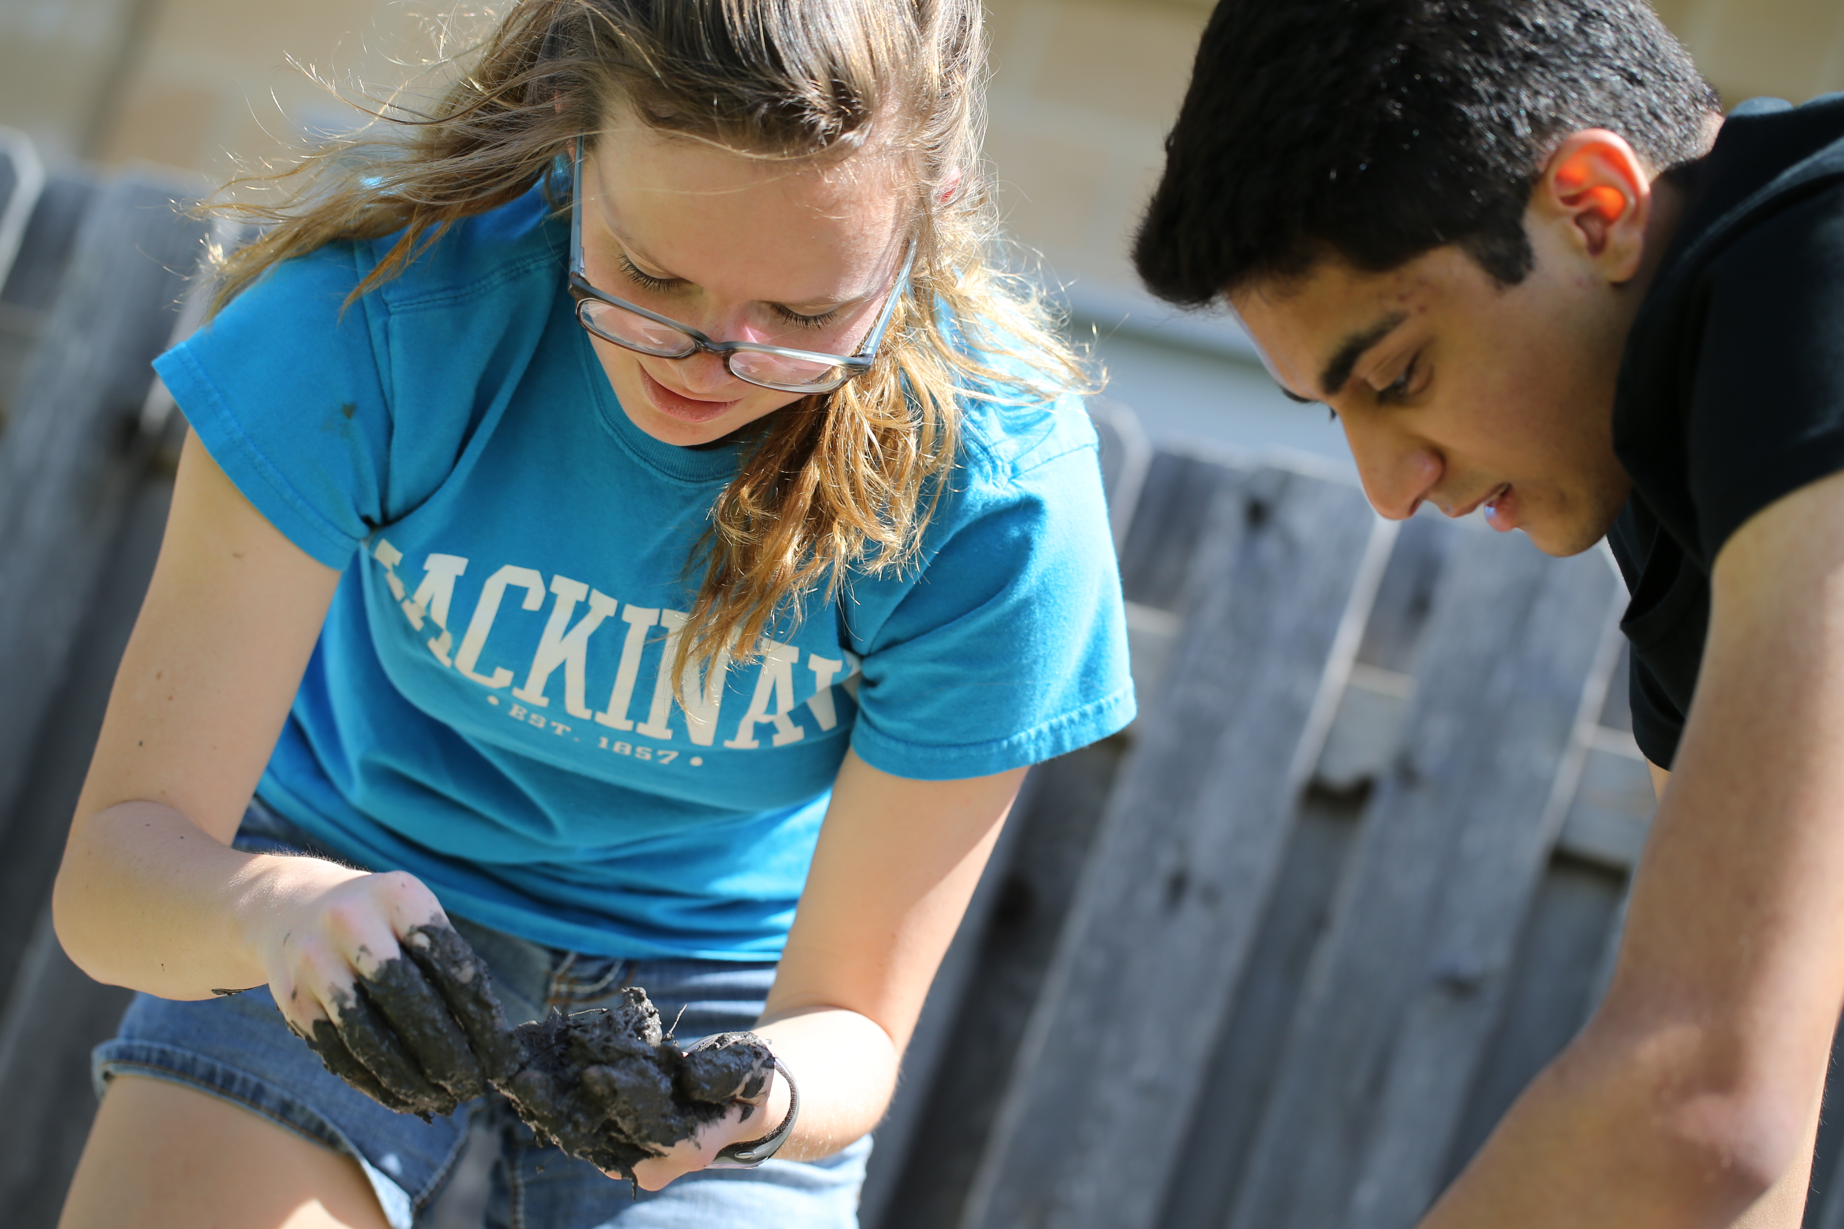
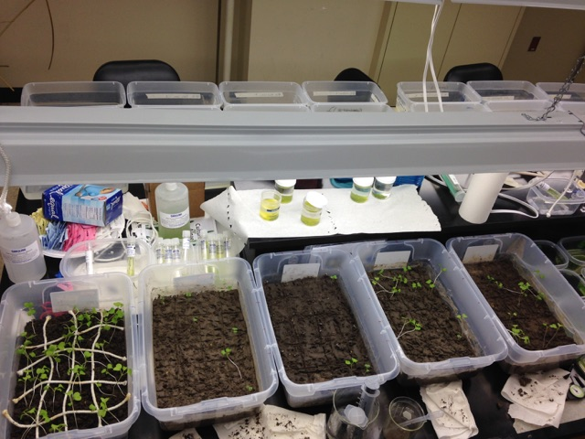
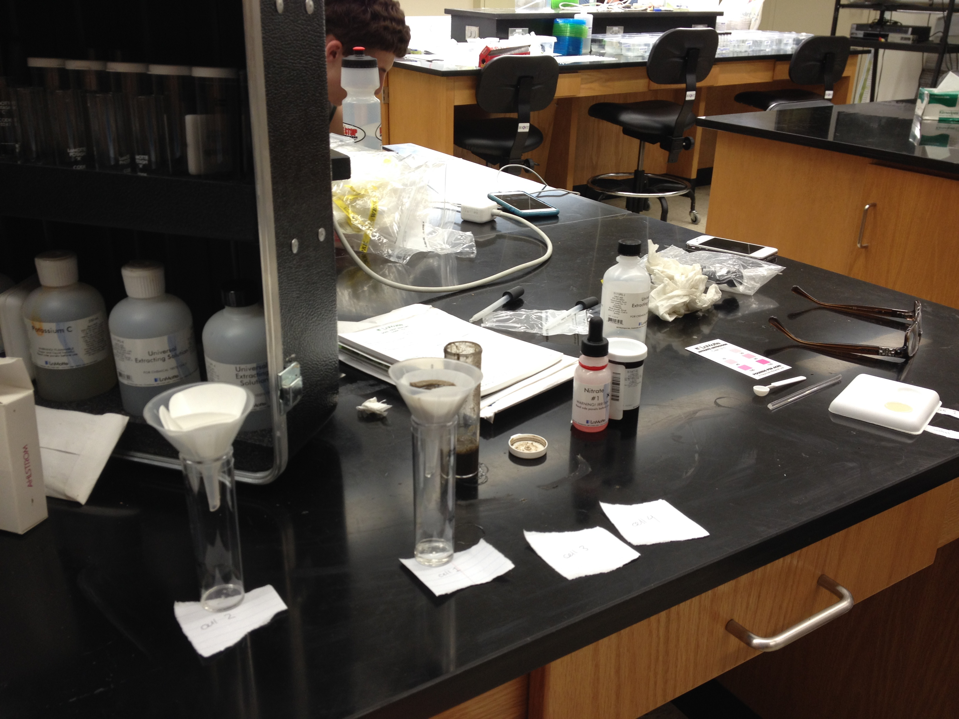
The Effect of Wetland Soil on Plant Growth
Kailey Ellis, Jacob Elnaggar, Taylor Horn
Bio 1406, Spring 2015, Baylor University, Waco, TX
Abstract
The goal of this experiment is to determine from which area of the wetland the most fertile soil originates by using sediment samples as the growing medium for Brassica rapa. Through comparative measurements of plant height, wet mass, and chemical composition, it will be determined which soil sample was most supportive of plant growth. Results of the test proved that soil variation in the wetland was not as prevalent as what was assumed. Soil closer to the inflow area supported about the same amount of plant growth and samples from the outflow area were the mediums for significantly less plant growth. It was determined that terrestrial soil (the soil in the control sample) provided a better environment for the growth of Brassica rapa than did the aquatic soil.
Results
Materials and Methods
The Lake Waco wetland is comprised of four main cells, depressions of earth in which water is collected and treated. Three samples of approximately 4L in volume were collected from different collection zones in each cell. The underwater samples were collected at the water line. The control sample was collected outside of cell 1. The three samples from each cell were mixed into one large sample and large plant debris and rocks were removed (Fig.4, 5). Each sample was tested for its nitrogen and phosphorous composition using the LaMotte Soil Testing kit (Fig. 8). The soil was allowed to dry. Five containers were filled with sediment from each of the cells and divided into 20 sections (Fig. 6). The soil was moistened with 500mL of water/container. The Brassica rapa seeds were planted, two seeds/each of the twenty cells. The plants were watered every day. After the plants sprouted, watering was reduced to 60mL/container, and the heights of the plants were recorded every day for 10 days (Fig. 7).
Fig. 4: Sampling dirt
Fig. 6: Planting seeds
Fig. 7: Plant growth
Fig. 8 : Soil testing
Fig 5: Removing debris
Introduction
Wetlands are known to be one of the most productive biomes on Earth (Reece 2014). The characteristic clay-like soil may act as a medium upon which the diverse life found there thrives. It is very dense, increasing water retention and creating a lack of oxygen which, along with the trace and essential elements and organic matter found within, are vital to the overall greening and development of native plants (Sleezer 2014). For this reason, wetland sediment may act as a natural fertilizer, composing an integral part of soil that increases resistance to disease and enhances the yield of crops. It is hypothesized that the soil from the middle of the wetland will be most nutritious.
Discussion and Conclusion
The data did not provide sufficient evidence to prove that the soil from a certain cell in the wetlands fostered the greatest amount of plant growth, so the hypothesis was rejected. All cells and the control had equal concentrations of phosphorous and nitrate-nitrogen. The control was significantly more prosperous than the cells. All of the seeds sprouted and grew to above five centimeters. Data from cells one and two showed comparable results: their average heights, number of plants, and wet mass were almost equal (Fig. 1, 2, 3), proving them to be the most prosperous of the cell samples. It is possible that the density of the soil harvested from the wetland cells inhibited the sprouting of the plants while enabling ample water retention that could have created an anaerobic environment. This environment is known to expedite the formation of organic acids and, while beneficial to aquatic plants, damages the root systems of the terrestrial Brassica rapa thus repressing their growth (Schmidt 2010).
Literature Cited
Stolt, M.h., M.h. Genthner, W.l. Daniels, and V.a. Groover. "Spatial Variability in Palustrine Wetlands." Soil Science Society of America Journal 65.2 (2001): 527. Web. 08 Mar. 2015.
Bai, Junhong, Hua Ouyang, Rong Xiao, Junqin Gao, Haifeng Gao, Baoshan Cui, and Laibin Huang. "Spatial Variability of Soil Carbon, Nitrogen, and Phosphorus Content and Storage in an Alpine Wetland in the Qinghai–Tibet Plateau, China." Australian Journal of Soil Research 48.8 (2010): 730. Web. 08 Mar. 2015.
Schmidt, Fabiana, Magali A. Strong, Leandro Bortolon, Elisandra S. Bortolon, and Rogério S. Oliveira. "Critical Level of Toxicity of Acetic Acid in Alternative Crops to Lowland Soils." Rural Science 40.5 (2010): 1068-074. Web. 08 Mar. 2015.
Reece, Jane B., Lisa A. Urry, Michael L. Cain, Steven Alexander Wasserman, Peter V. Minorsky, Rob Jackson, and Neil A. Campbell. "Chapter 52." Campbell Biology. 10th ed. Glenview: Pearson Education, 2014. N. pag. Print.
Acknowledgments
We would like to thank Nora Schell, Lake Waco Wetlands Coordinator; Dr. Marty Harvill; Jennifer Teague, lab assistant; and the Baylor Biology Department.

